Slide 1
Watersheds

Slide 2
So, what is a watershed anyway?

Slide 3
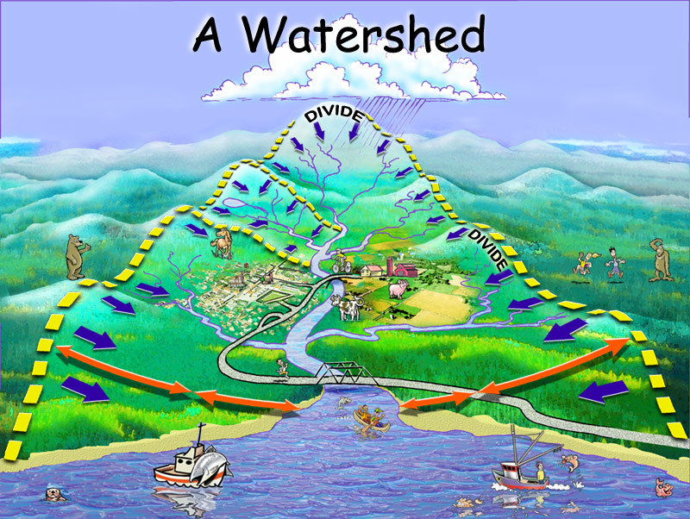

Slide 4
Watershed
An area of land from which water (rain, melting snow) drains into a particular river

Slide 5
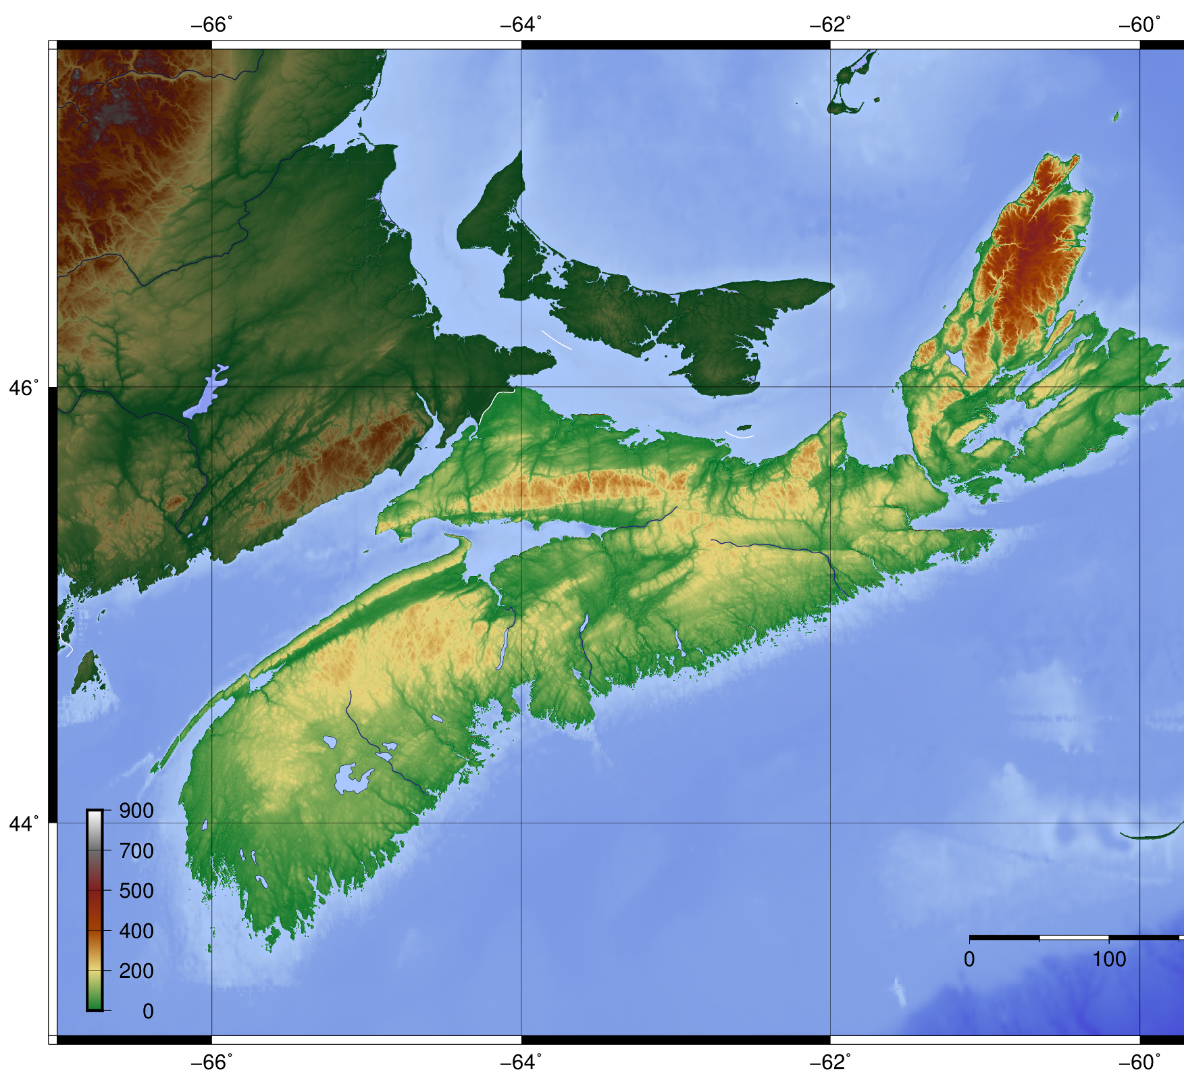
Nova Scotia Watersheds

Slide 6
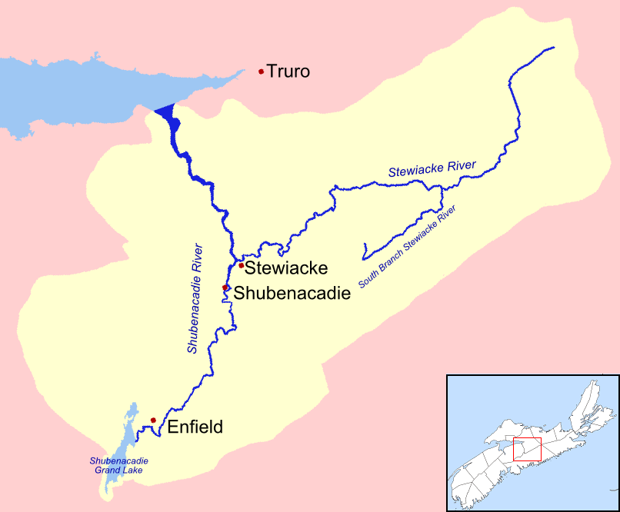
Shubenacadie/Stewiacke Watershed

Slide 7
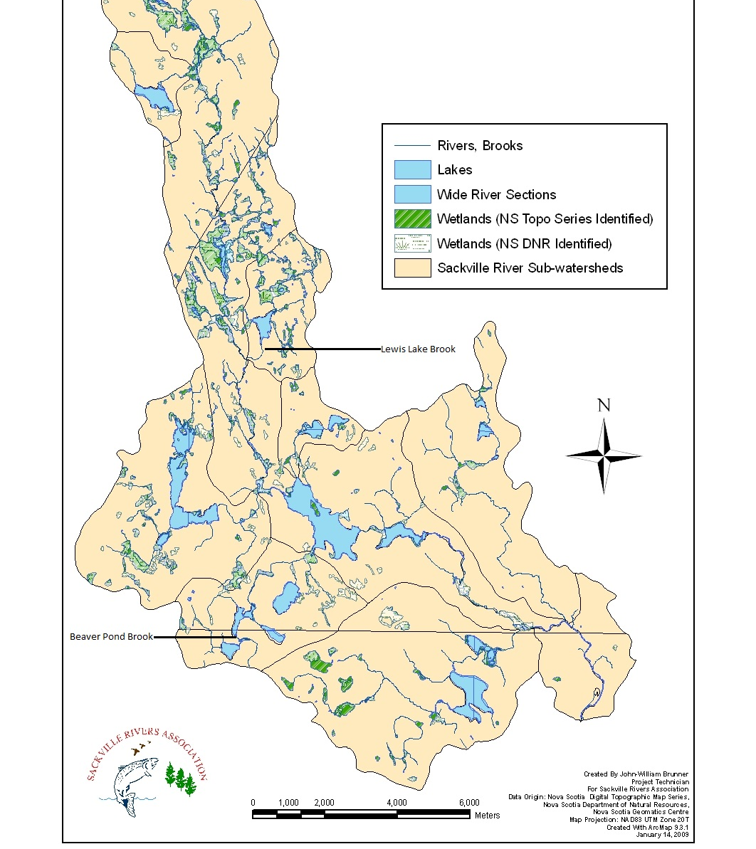
What watershed do you live in?
The Sackville River Watershed!

Slide 8
Watersheds and Living Things
Many living things exist in a watershed.
In a watershed there are THOUSANDS OF DIFFERENT KINDS of living things.
Algae, grasses, mosses, ferns, bushes, trees
Bacteria, fungi, worms, insects
Snakes, turtles, salamanders, frogs, toads, birds, fish and mammals like squirrels, mice, chipmunks, rabbits, foxes, coyotes, deer, people
And many many more!
A healthy watershed provides a suitable environment or HABITAT for all of them

