Slide 1
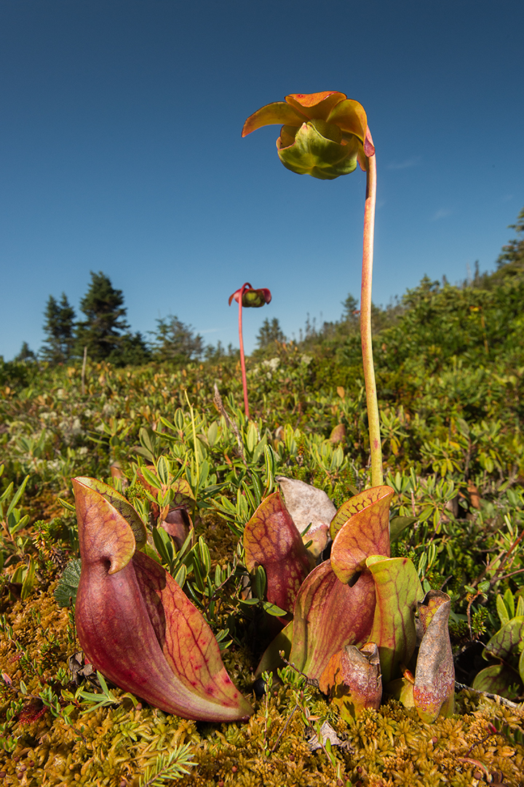
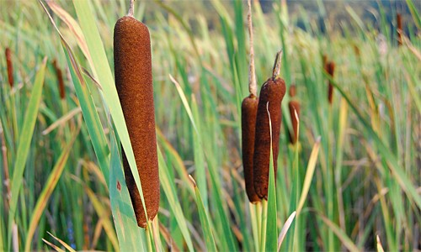
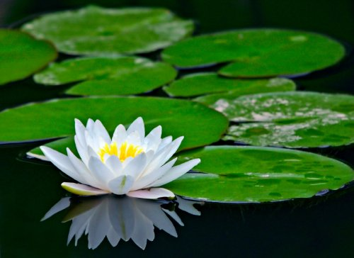
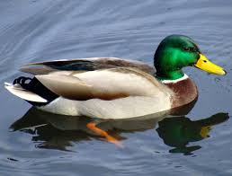
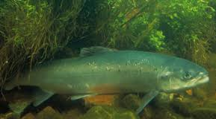
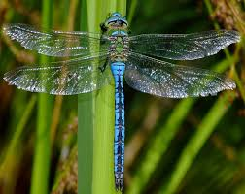
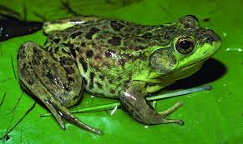
Plant and Animal Adaptations to Life in Rivers, Lakes and Ponds

Slide 2
Structural Adaptations
Structural adaptations are structures or features of plants and animals that allow them to survive and reproduce.
What kinds of adaptations make plants and animals well suited to life in rivers, lakes and ponds such as those in the Sackville River watershed?

Slide 3
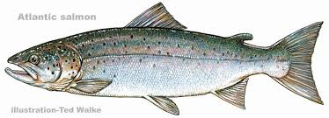
Atlantic Salmon
Atlantic Salmon
Body Shape
Swim fast
Catch prey
Escape predators
Move easily through strong ocean and river currents
Lateral Line
Detect movement in water
Identify prey/predators in murky water
Navigate in river and ocean
Special Gills and Kidneys
Enable salmon to live in both fresh and seawater

Slide 4
White Sucker
Downward facing mouth
Enables fish to feed easily on food found on or in the mud
Fish can feed without being seen by predators
Soft/Sensitive lips
Fish can “taste” the mud to identify food
Dark coloured upper body
Fish is hard for predators to see from above

Slide 5
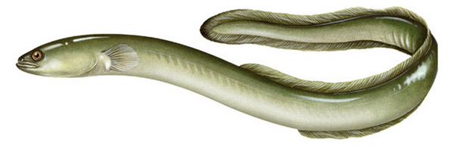
American Eel
The American Eel is thin and long so it can fit into narrow spaces between rocks or under logs to wait for prey or hide from predators
It’s dark color makes it hard to see for both prey and predators
The shape of its fins allow it to swim well even though it has such a long body

Slide 6
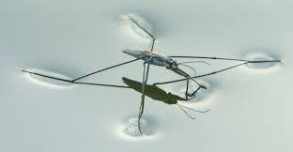
Water Strider
Water striders are light and have big feet
They stand on the water!
Their feet have tiny hairs that repel water and capture air. This helps them stand on water and gives them “traction” so they can move.

Slide 7
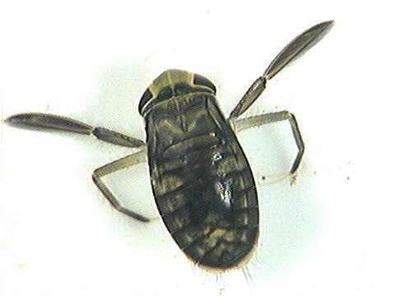
Water Boatman
It’s hind legs work like oars so it can move quickly along the water surface
The front legs end in spoon shaped scoops that scrape algae off plants, rocks or mud
It produced digestive juices that it “spits” into the algae that it has collected in its scoops to start digesting the algae before the boatman has even swallowed them

Slide 8
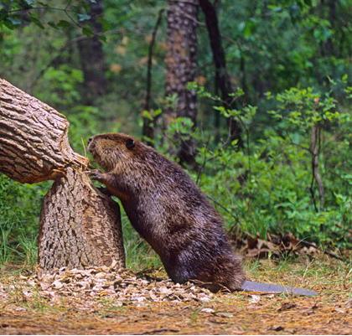
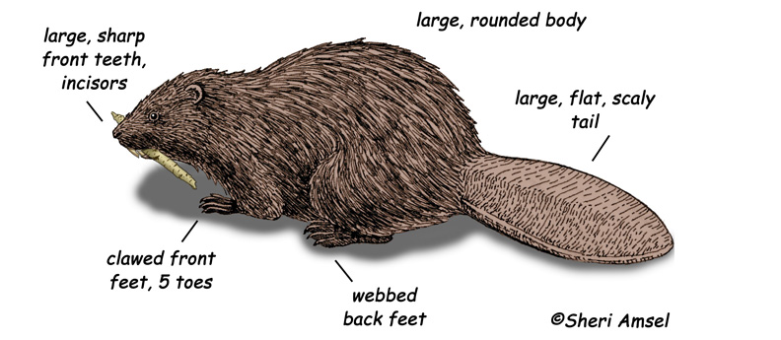
Beaver
Large, sharp front teeth and very strong jaw muscles to cut through wood
Front teeth never stop growing so beaver can cut wood for its whole life
Oily fur to repel water
Thick layer of fat under the skin to keep animal warm in cold water
Webbed feet and flat tail help with swimming

Slide 9
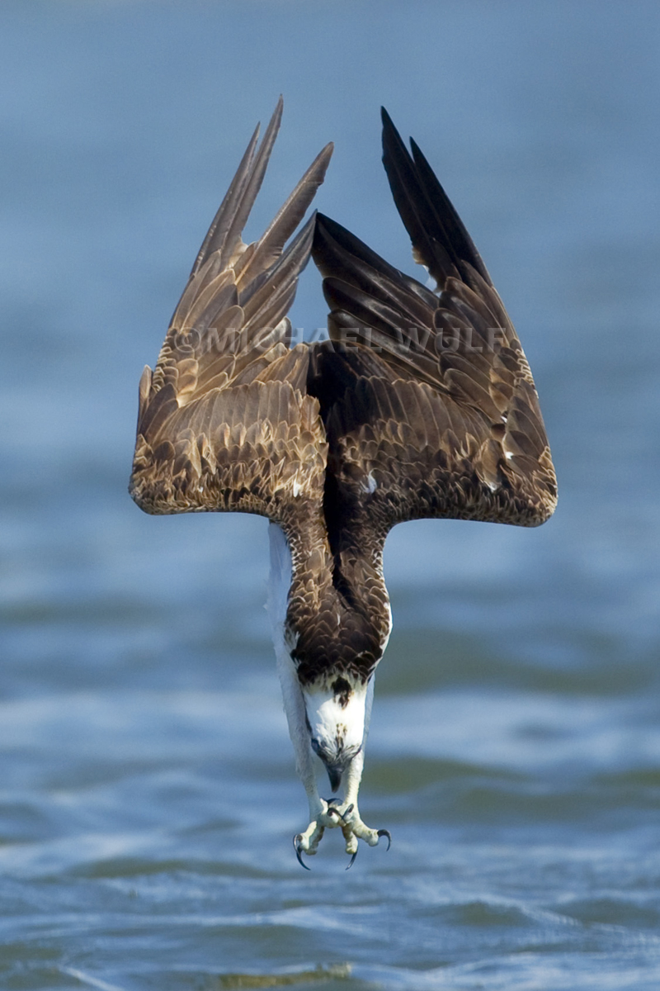
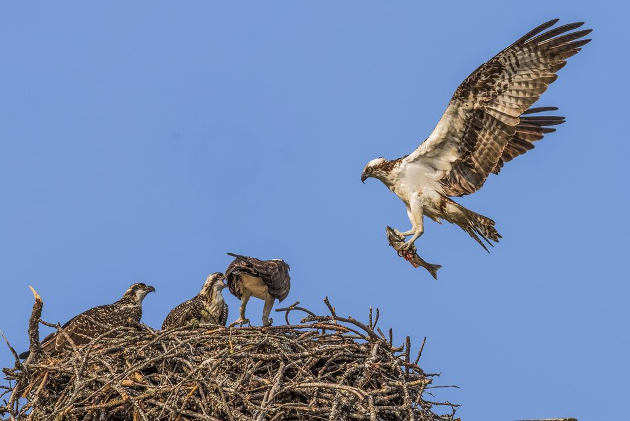
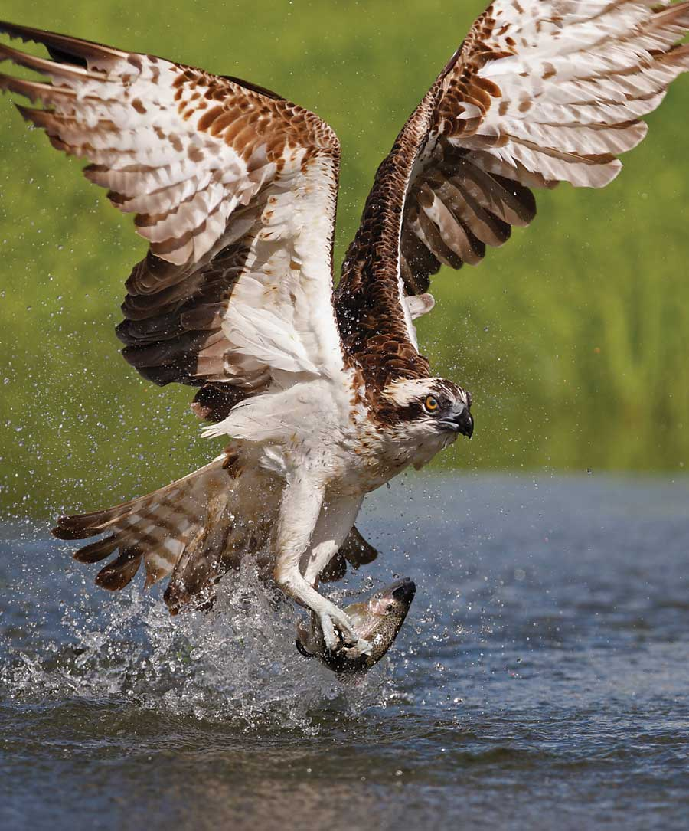
Osprey
Large, broad wings to soar for long periods with little effort
Ability to hover while searching for fish
Superb vision to see fish in water from great heights
Sharp talons for grabbing fish
Oily feathers that dry quickly so bird doesn’t stays warm

Slide 10
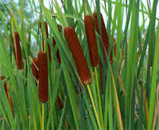
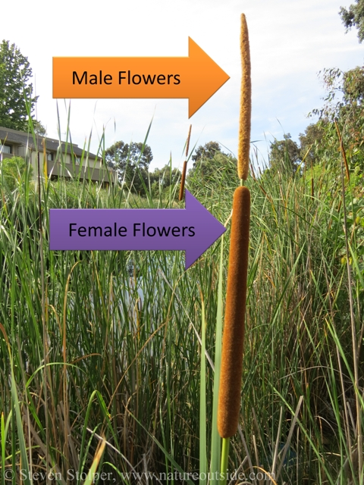
Cattails
The stems and leaves contain tiny tubes that carry air down to the roots that are under water
Highly branched roots to keep plants from falling over even when growing in soft mud
The male flowers are above the female flowers so the windborne pollen they produce drifts down onto the female flowers. Results in effective reproduction
Their seeds are tiny and easily dispersed by wind, allowing the plants to quickly spread

Slide 11
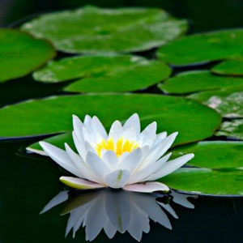
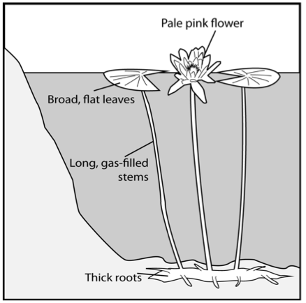
Water Lily
The leaves have many small pores on their upper surface to allow air into the leaf. The air
Keeps the leaf afloat
Travels down the stem through special tubes to provide oxygen to the roots
Thin, flexible stems. No need to build a strong stem since the leaf the is held up by water

